Slide 1
Canny edge detection using hls
By
B.V.Venu Gopal

Slide 2
Canny edge detection
The Canny edge detector is an edge detection operator that uses a multi-stage algorithm to detect a wide range of edges in images.
Gaussian Blur is used to reduce the noise in the image and make the image smooth.
Sobel Edge detection is used for finding the sudden change in intensity of the pixels.
Sobel edge detection finds the gradient in X and Y direction.
Non Maximum Suppression is used to suppress the pixels which do not have non maximum values.
Double thresholding is done to divide the pixels into strong , weak and rest pixels.
Weak pixels are set to zero and strong to 255.
Hysteresis Edge tracking is done to attach the isolated pixels with strong pixels if they are near by.
GAUSSIAN BLUR
SOBEL EDGE
DETECTION
NON MAXIMUM SUPPRESSION
DOUBLE
THRESHOLD
HYSTERESIS

Slide 3
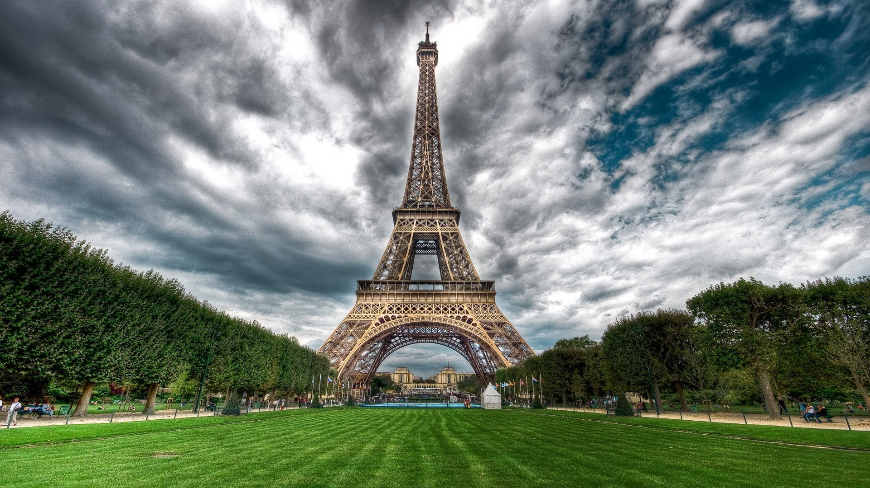
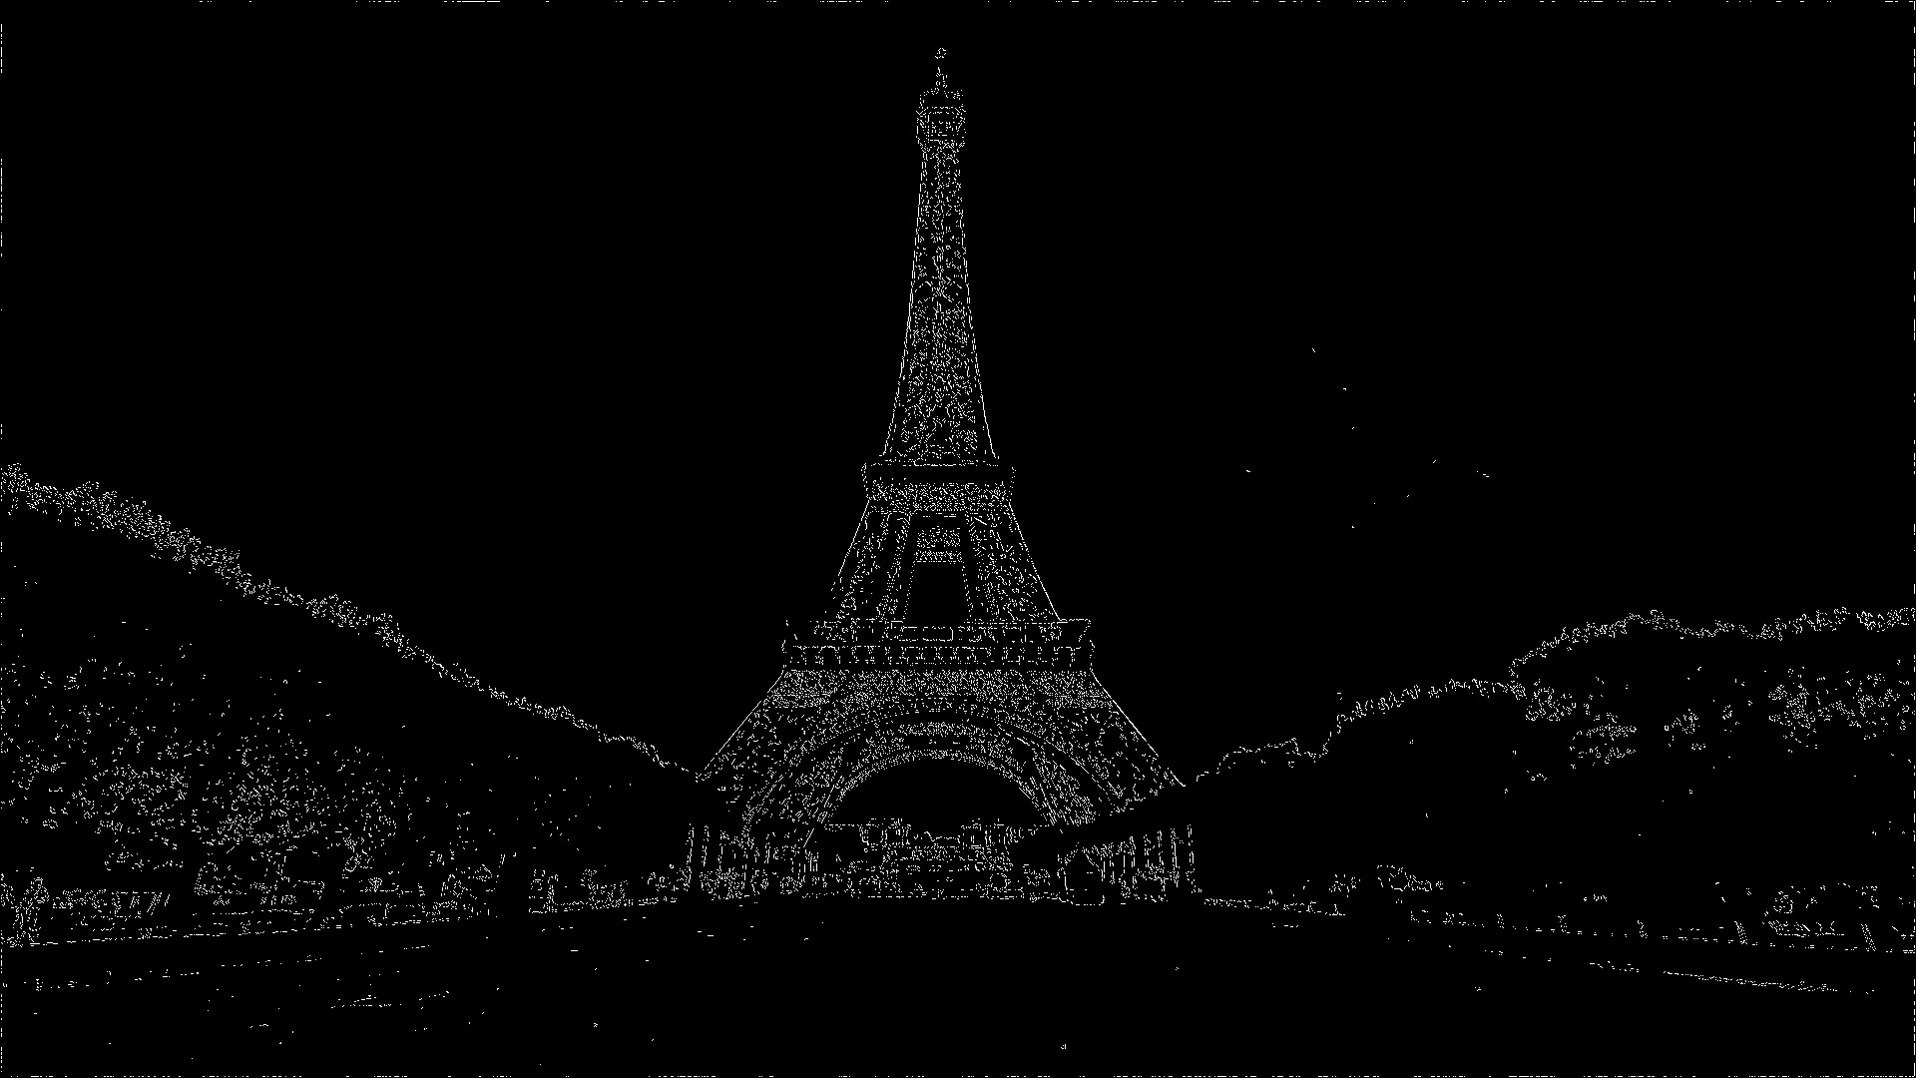
Input Image
Output Image

Slide 4
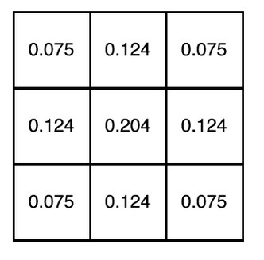
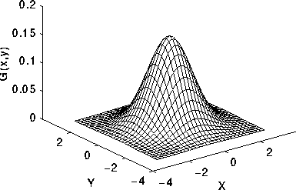
GAUSSIAN BLUR
Gaussian Blur is an image processing technique used for noise reduction in an image.
Gaussian Blur is done by convolution of a kernel matrix and an image.
The Gaussian kernel is a kernel with gaussian or normal distribution with the peak at the center of the kernel.
The convolution of the image and kernel makes the image smooth and reduces the noise.
A 3x3 Gaussian kernel

Slide 5
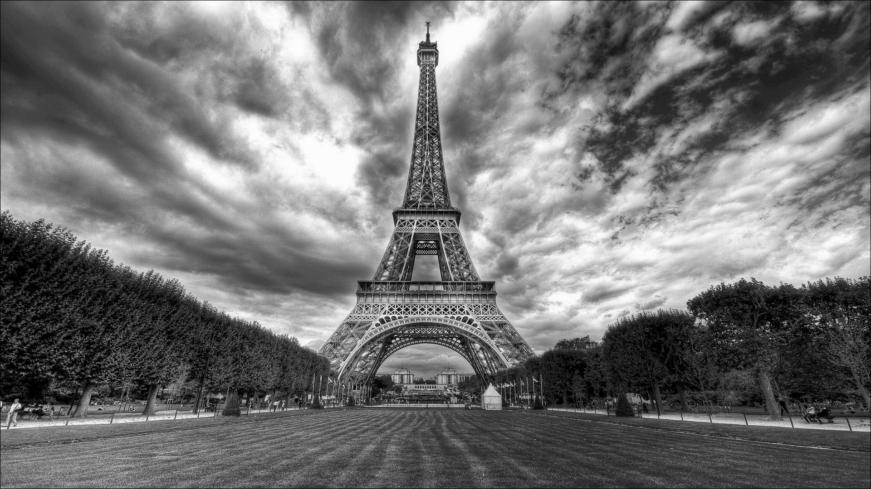
Input Image
Output Image

Slide 6
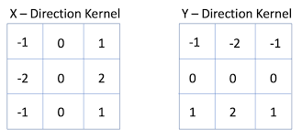
Sobel edge detection
Sobel Edge Detection finds the gradient of the image intensity by which finds the edges in the image.
We take two gradient kernels for x and y axis. Convolution is done between image and these kernels.
We then find the magnitude by the help of X gradient and Y gradient.

Slide 7
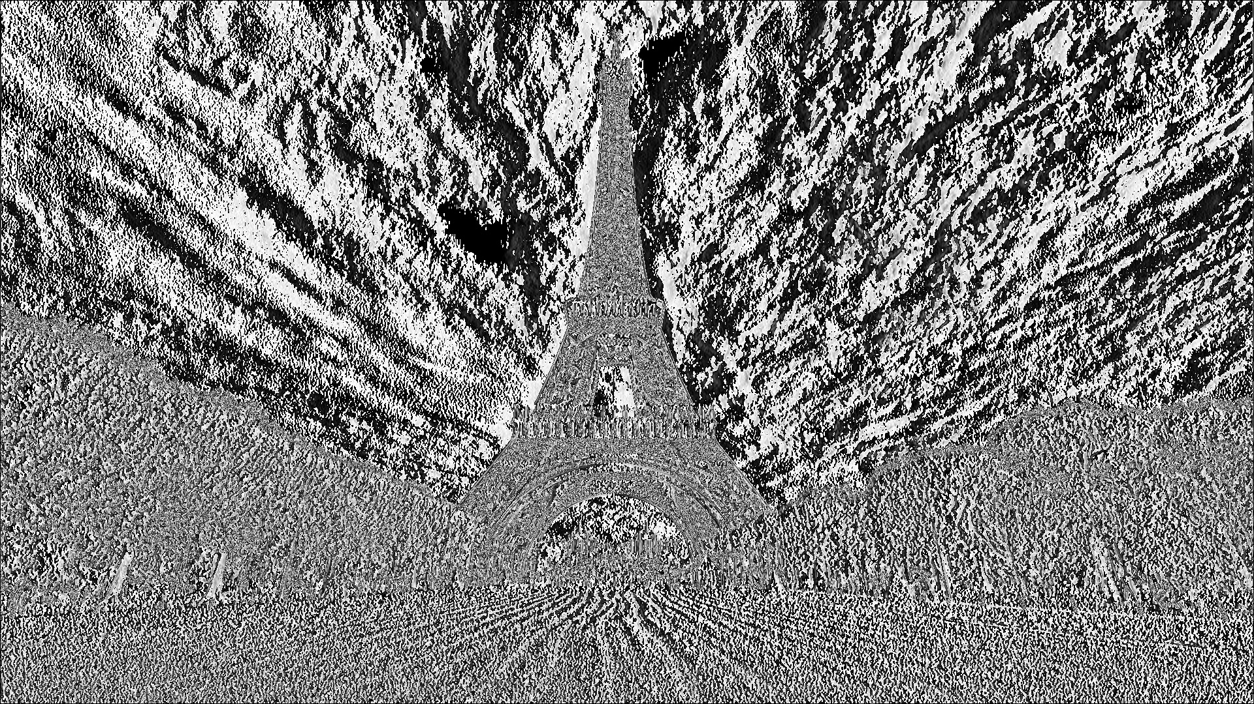
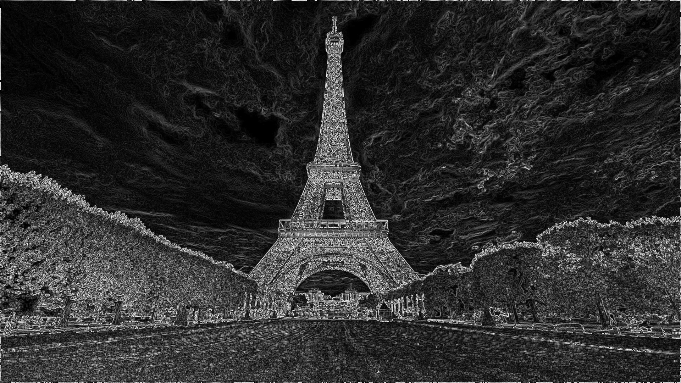
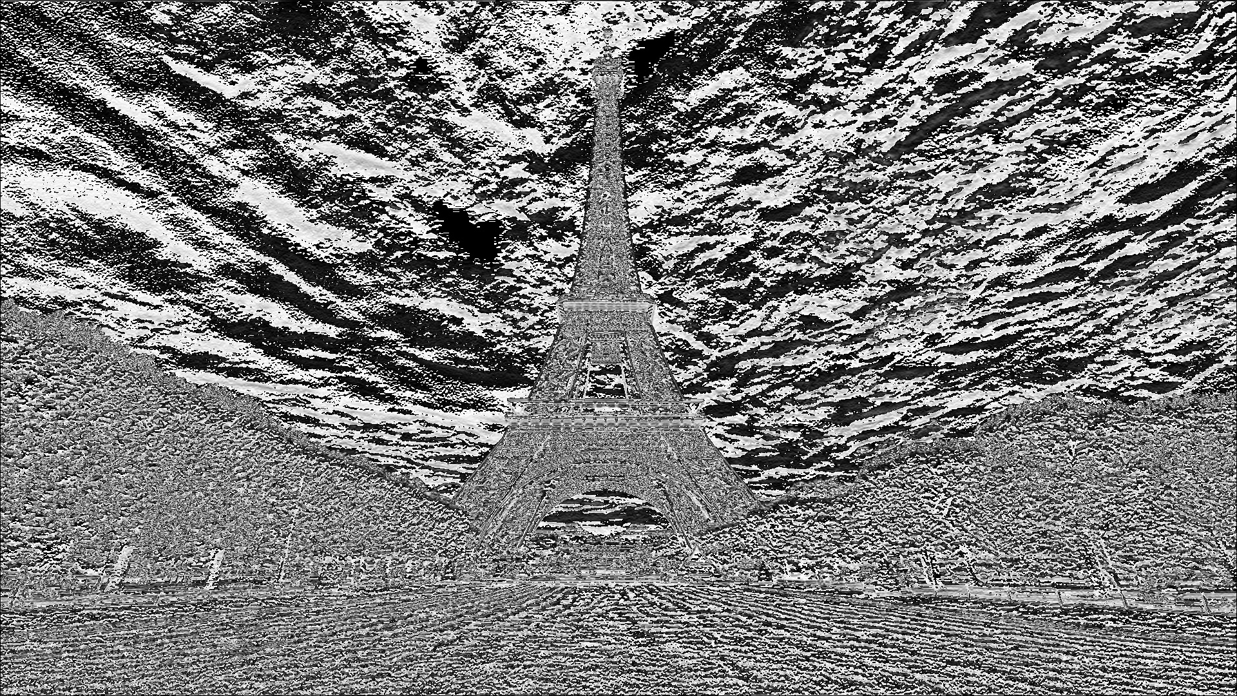
X gradient
Y gradient

Slide 8
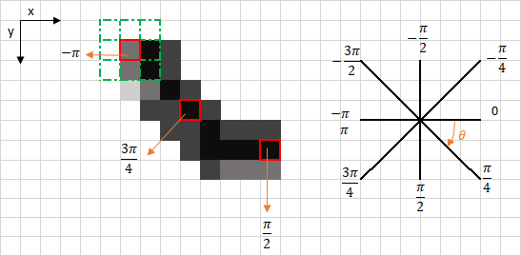
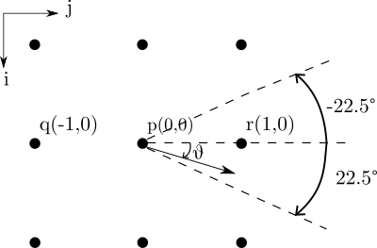
Non maximum suppression
Non-maximum suppression is an edge thinning technique. We find the direction of the gradient and if the given pixel is local maxima in that direction it is left as it is ,Otherwise it is changed to zero.
This removes pixels that are not considered to be part of an edge. Hence, only thin lines will remain.
The direction of the gradient is found out by arctan(gy/gx).

Slide 9
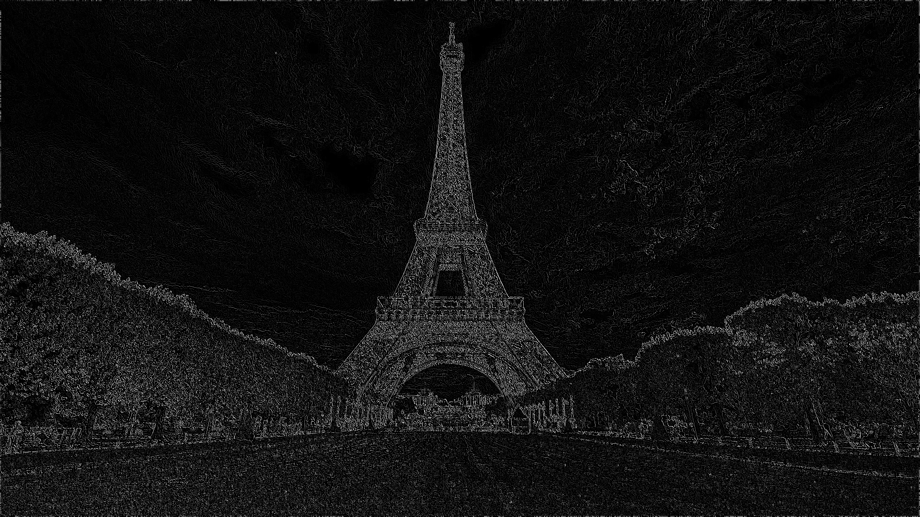
In the direction of
atan(dy/dx)

Slide 10
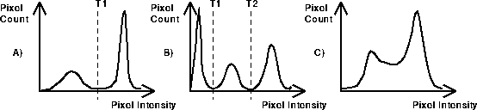
Double thresholding
We find two thresholds for dividing the pixels into three segments which are strong , weak and rest.
Strong pixels are the pixels which have high intensity and are must for the image, weak pixels are pixels which do not contribute enough and are very dim to consider and are ignored.
Rest are not so strong and not very weak.
Strong pixels are given the highest value of intensity , rest are given moderate values and weak are kept at zero.

Slide 11
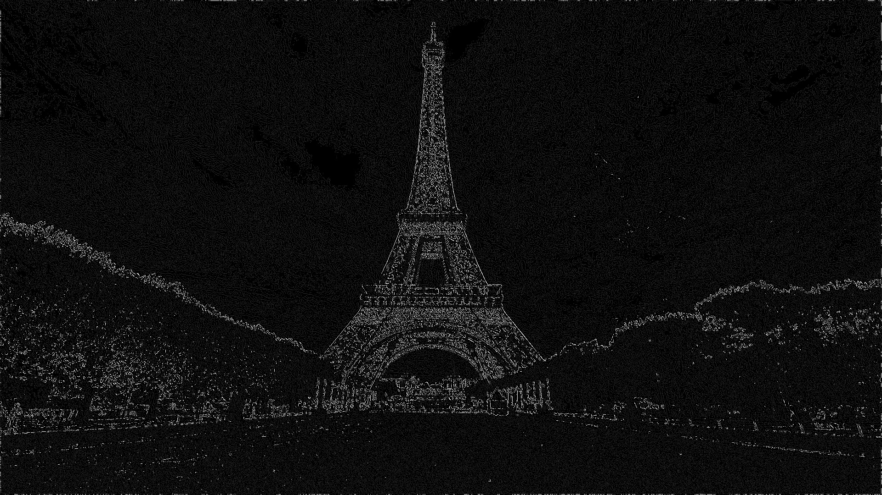

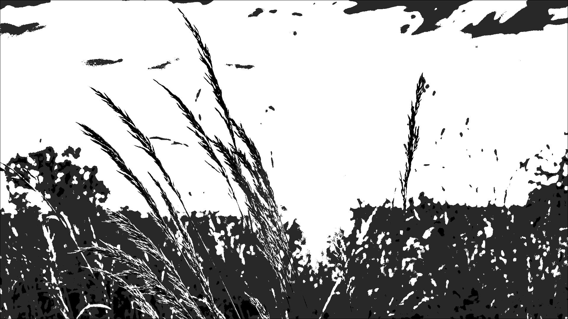

Slide 12
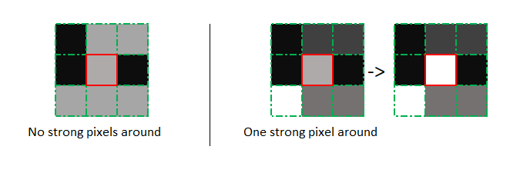
Hysteresis Edge tracking
This is the last step in canny edge detection. In hysteresis edge tracking the weak pixels found out in double thresholding are checked whether they are adjacent to any strong pixel.
If there are adjacent to any strong pixel they are made strong otherwise set to zero. This makes sure that the image is not broken.

Slide 13
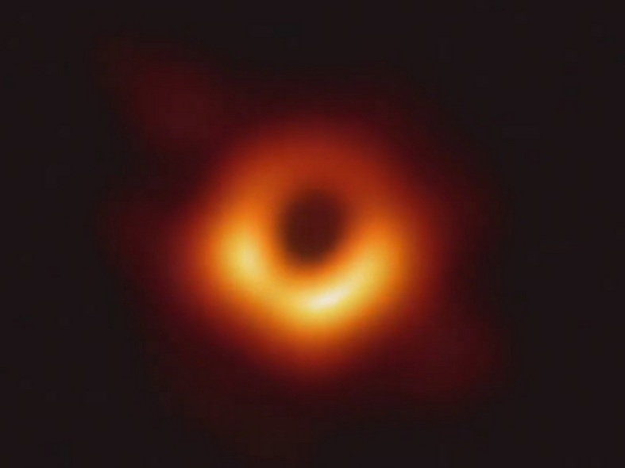
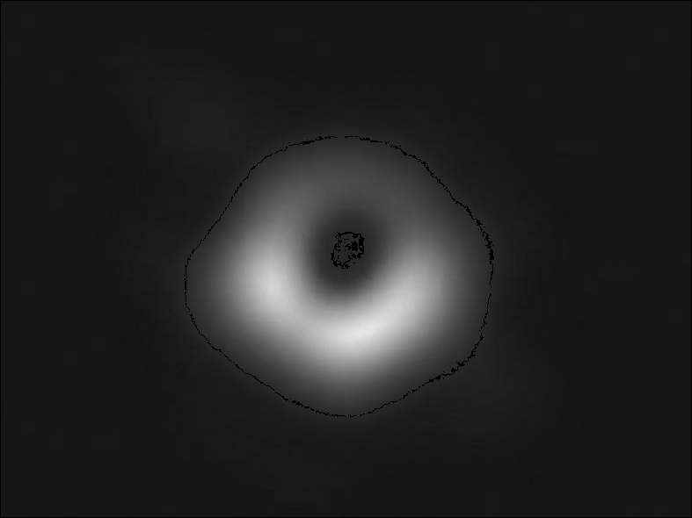

Slide 14
Thank you

